Slide 1

Book
Recommendations
System

Slide 2

Mentors And Team Members
Mentors
•
•
Dhanyapriya Somasundaram
Karthik Muskula
Team Members
•
•
•
•
•
•
Ashish Shinde
Disha Sharma
Dhiraj Navale
Jayesh Patil
Pournima Kotgiri
Shaheen Begum

Slide 3
Contents
1. Project Architecture
2. Introduction to Recommendation System
3. Data set Details
4. Data preprocessing and Eda
5. Visualization
6. Details about recommendation techniques
7. Model selection
8. Deployment

Slide 4
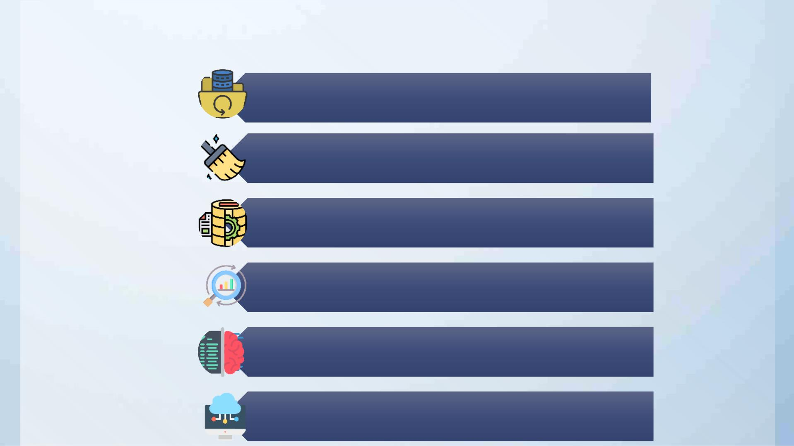
Project Architecture
Datasets
•Import Libraries
•Load Data-sets
Data Cleaning
•Missing Value Treatment
•Checking duplicates
Data Preprocessing / EDA
•Rename column names
•Construct an extra column for the location
•Changes in the inappropriate blanks values in columns
Data Visualization
•Numerical Data Visualization
•Barh Chart, Pie-Chart, Bar Graph, Histogram
•Outliers Detection through Boxplot
Model Selection
Model Deployment

Slide 5

2. Introduction To Recommendation
Ø Recommendation systems involve
predicting user preferences for
unseen items.
Ø Recommendation systems have
become very popular with the
increasing availability of millions of
products online
Ø Recommending relevant products
increases the customer’s interest
and sales of the company.
Ø Examples:-
Ø Facebook-” People You May Know”
Ø Netflix-” Other Movies You May Enjoy”
Ø Amazon-” Customers Who brought
this item also brought…”

Slide 6
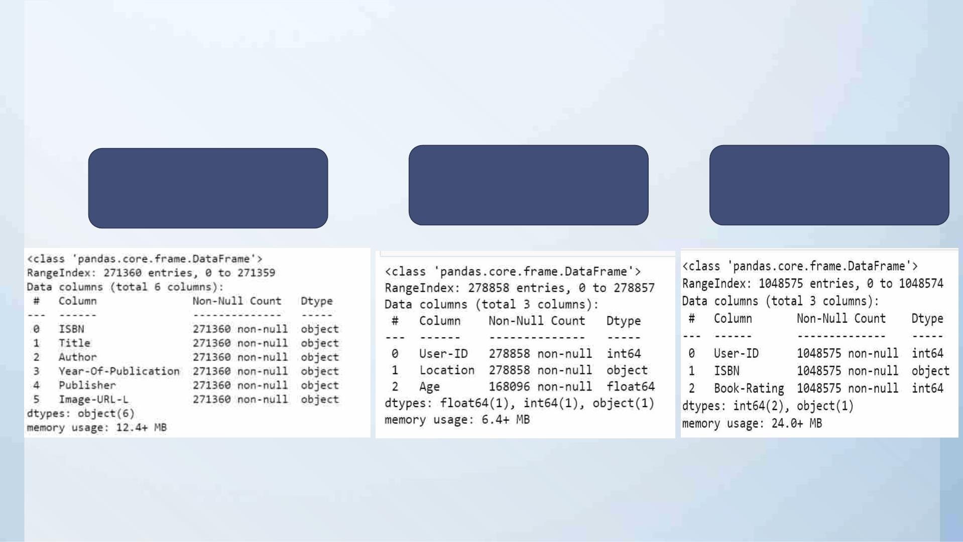
3. Datasets Details
Book Dataset
• No. of rows:-271360
• No. of columns:-8
Users Dataset
Rating Dataset
•
No. of rows:-278858
No. of columns:-3
•
No. of rows:-1149780
• No. of columns:-3
•

Slide 7

4. Data Preprocessing
In Books Dataset
v Checking of null values
and missing data.
v Removal of two columns of
small image URL and large
image URL.
v Changing column names
for easy recognition.
v In the publisher column
missing value with others.
v In the Year Of Publication
column we have two
In Users Dataset
v In the Users dataset in the
Age column we find
unique values and with
that, we calculate the
mean age.
In Rating Dataset
v In this data set we check
Book-rating and User-Id are
columns that are numerical
type.
v In the Location columns,
we have combined
information about the city,
state, and country we split
this information into three
different columns.
v In the ISBN column we
remove extra characters.
object data DK Publishing
Inc replaced this with 2000
and Gallimard replace it
with 2003.

Slide 8
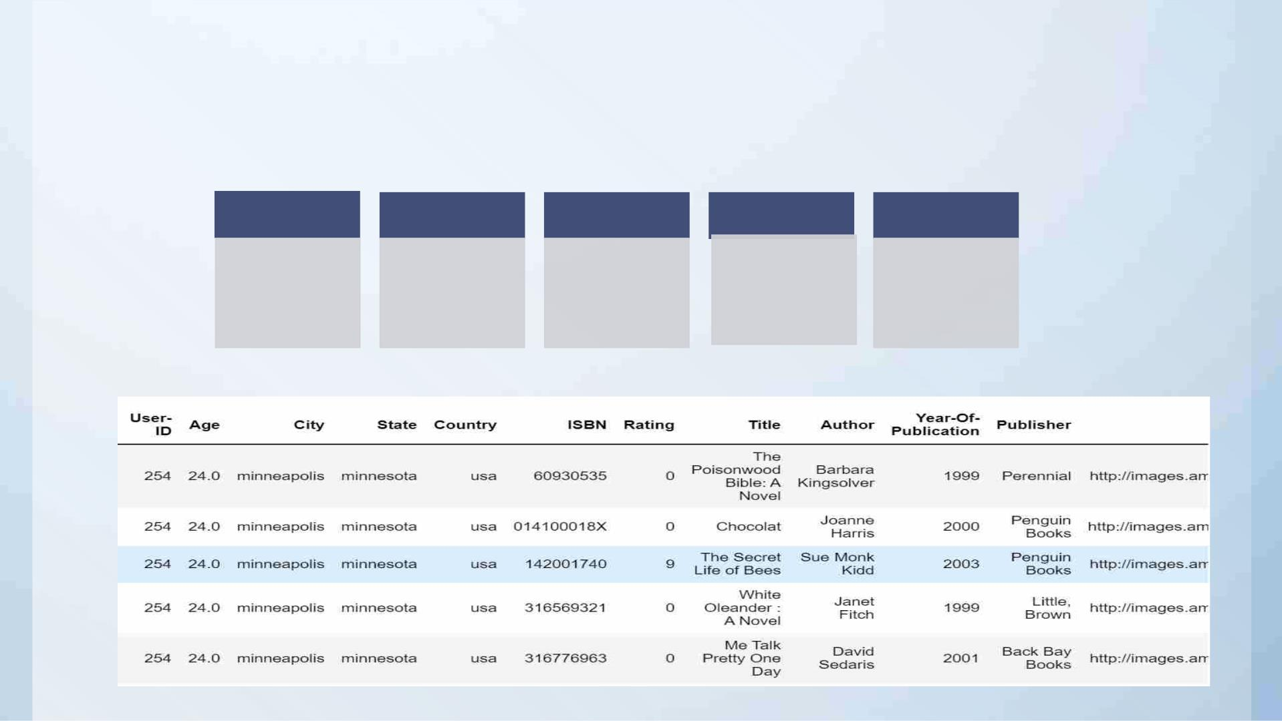
Final Dataset Details
After applying preprocessing on all three datasets. We merge all and made the final data set for
visualization and model building.
Datasets
Rows And
Columns
No. Of Unique
User-ID
Null Values
Data Types
•Final Dataset
•50815 Rows
•8 Columns
•95513
•Total null
values of all 3
datasets are6
•Int(32) 1
•After merging
columns
of all three
•Object 8
columns
preprocessed
datasets

Slide 9
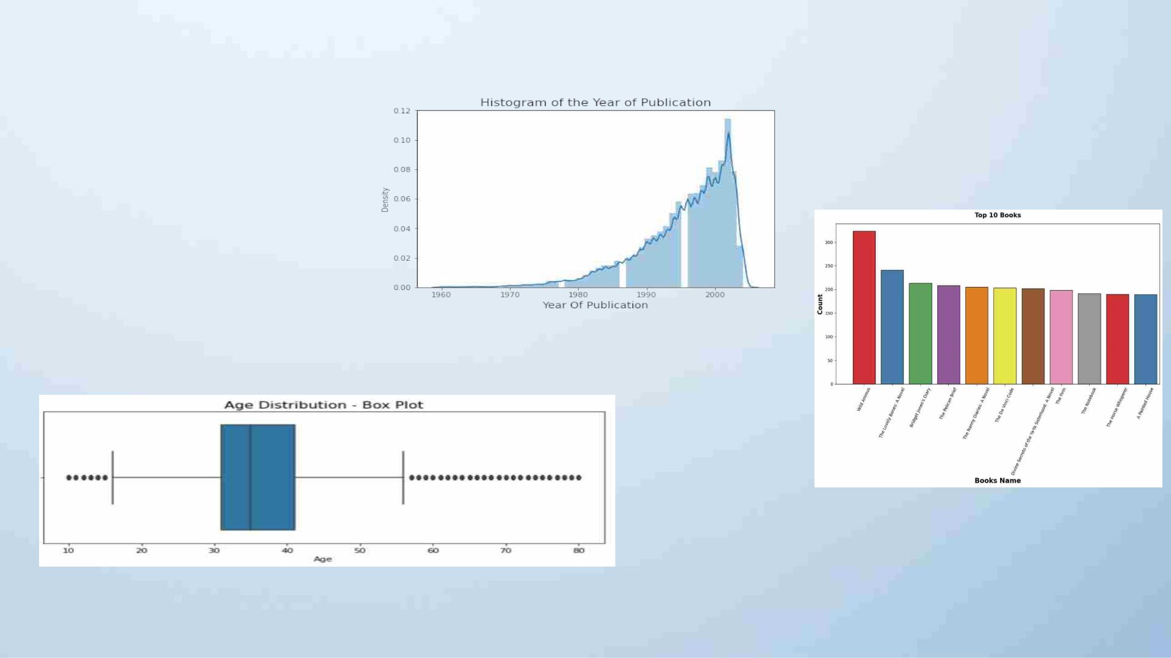
5. Visualization
v In Histogram represents
v Graphical representation of top
the Year Of Publication
From 1990 to 2005 we saw
there are many publishers.
10 books
•
v Outliers
§
§
There are many outliers in age columns
Outliers are treated with mean values.

Slide 10
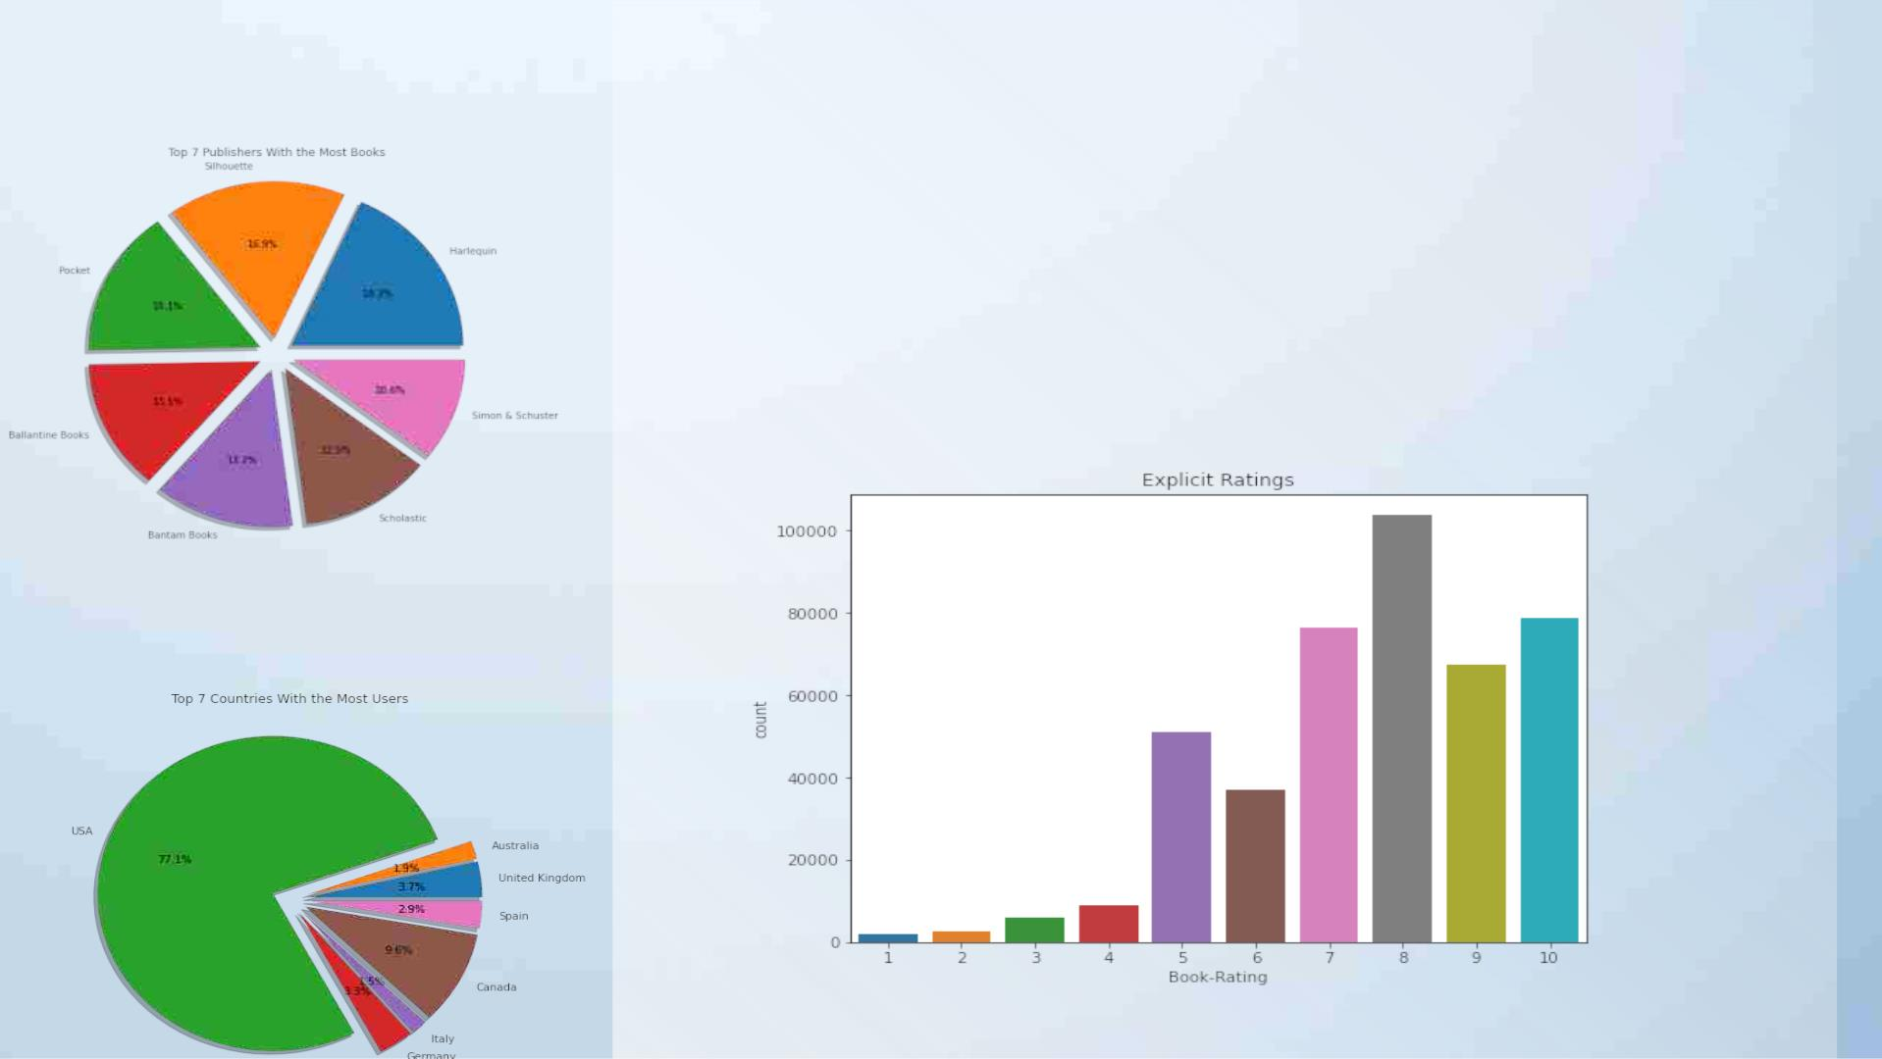
v Top 7 Publishers With the
Most Books
v Divide the complete dataset based on implicit and explicit
ratings.
•
•
•
•
In the Explicit dataset we get a rating above zero
In the Implicit dataset we get a rating of zero.
So we select the Explicit dataset.
In Explicit rating we find that more people rated above 6 and most of the people
rated 8.
v Top 7 Countries With the Most
Users

Slide 11
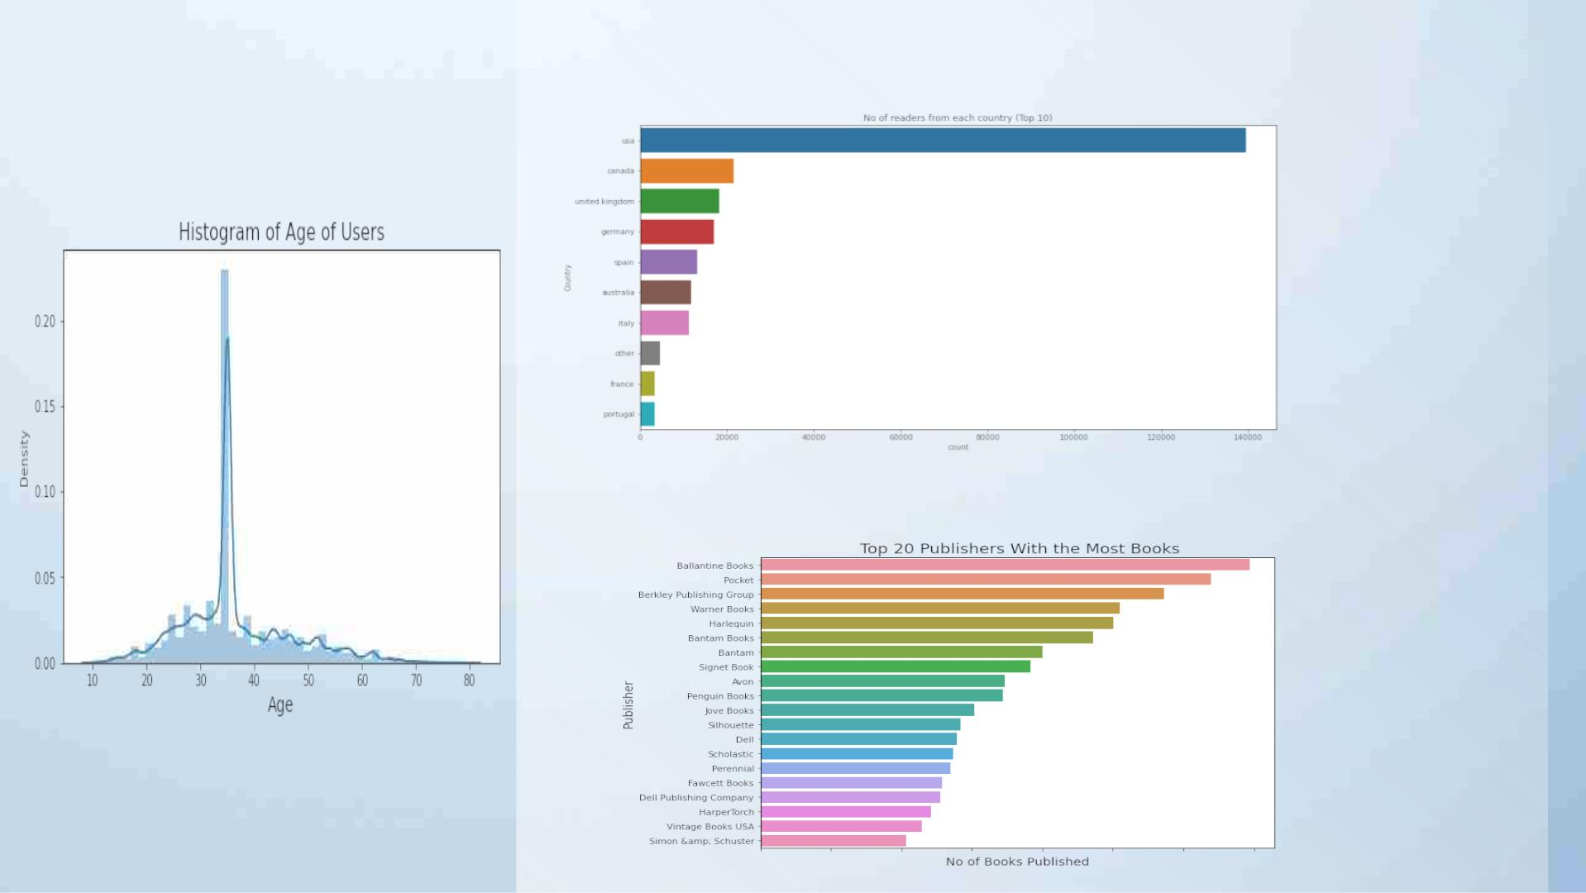
v Below Histogram
Represents the age of
users.
v Top 15 Highest Reader From Countries
• Aged between 30 to 40
most users read books.
v Top 20 Publisher With The Most Book

Slide 12
6. Recommendation Techniques
6.1 Popularity-Based Recommendation System :-
It is a type of recommendation system which works on the principle of popularity and or anything which is in
trend. These systems check the product, movies, or books that are in trend or are most popular among the users
and directly recommend those.
Ø Advantage of popularity-based recommendation system
§
There is no need for the user’s historical data.
Ø Disadvantage popularity-based recommendation system
§
The system would recommend the same sort of products/books which are solely based on popularity to
every other user.

Slide 13
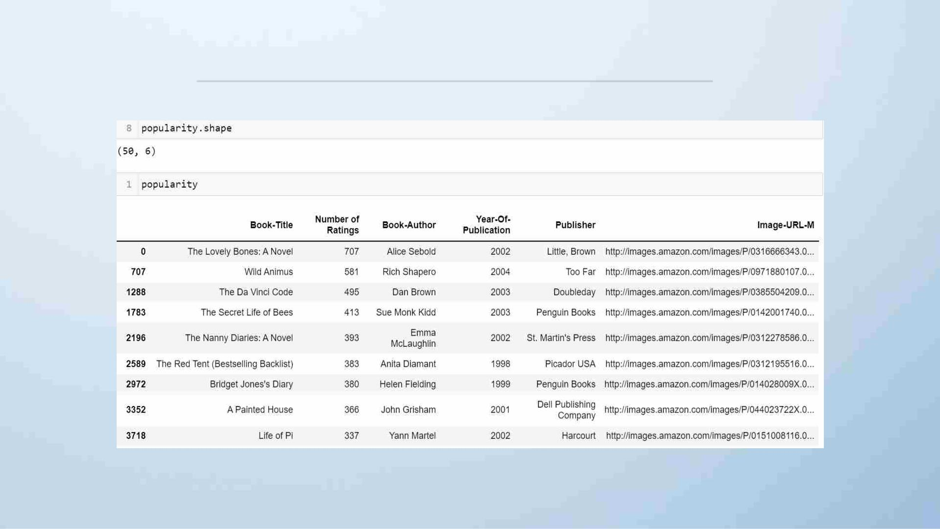
PPooppuullaarriittyy--BBaasseedd RReeccoommmmeennddaattiioonn SSyysstteemm DDaattaaffrraammee

Slide 14

6.2 Content-Based Filtering:-
A content-based recommender works with data that the user provides, either
explicitly (rating) or implicitly (clicking on a link). Based on that data, a user
profile is generated, which is then used to make suggestions to the user.
Ø Advantage of content-based recommendation system
§ Able to recommend users with unique tastes.
§ Can explain the recommendation.
Ø Disadvantage of content-based recommendation system
§ Data should be in a structured format.
§ Unable to use quality judgments from other users.

Slide 15
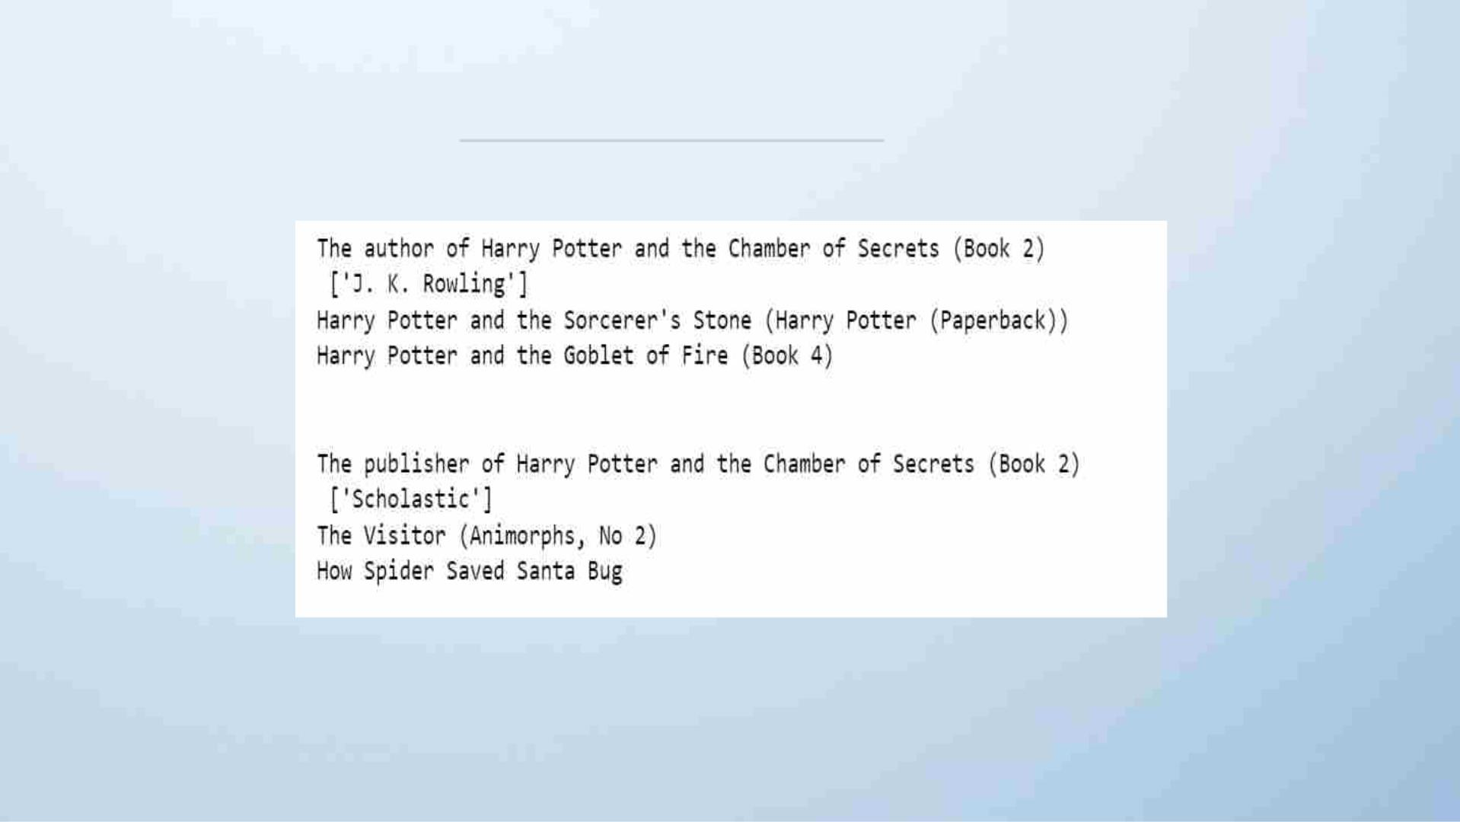
CCoonntteenntt--BBaassee FFiilltteerriinngg RReessuulltt

Slide 16

6.3 Collaborative Filtering:-
Collaborative filtering is used by most recommendation systems to find similar patterns or
information of the users, this technique can filter out items that users like on the basis of the
ratings or reactions by similar users.
Ø Advantages of collaborative filtering
§ Other user scores are used.
§ No deterministic result since chance is involved in the system.
Ø Disadvantages of collaborative filtering
§ Needs more data.
§ Problems with new users and new products.

Slide 17
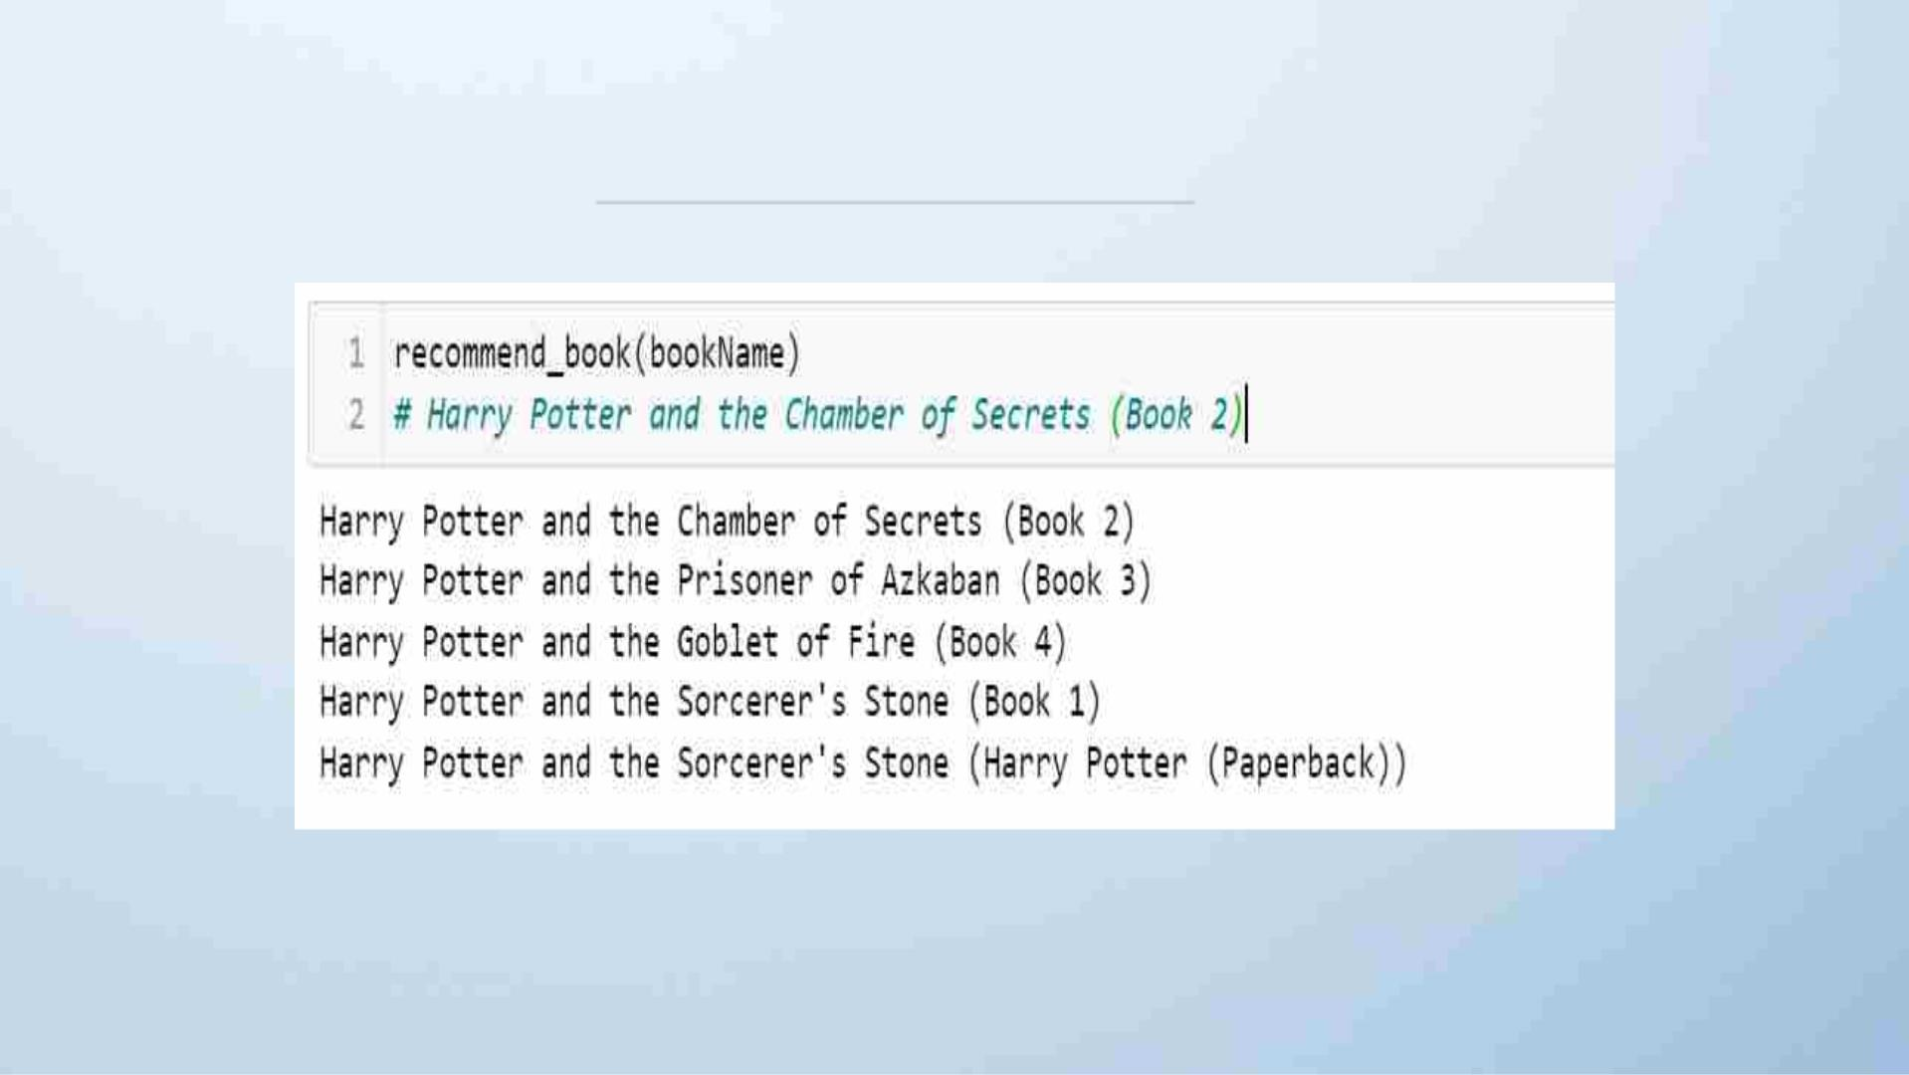
RReessuulltt OOff CCoollllaabboorraattiivvee FFiilltteerriinngg

Slide 18
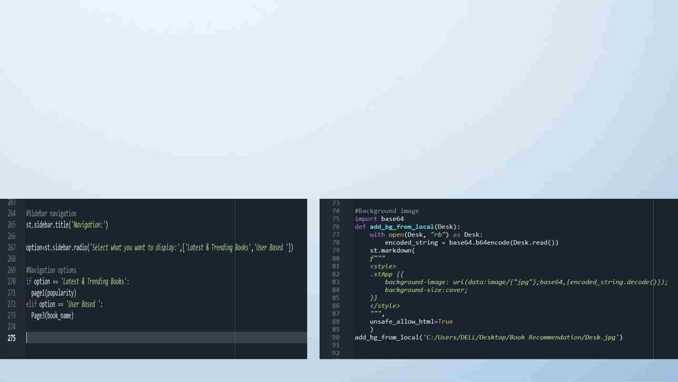
8. Deployment
Deployment is the process by which a ML model is moved from an offline environment and integrated into an existing
production environment, such as a live application. It is a critical step that must be completed in order for a model to
serve its intended purpose and solve the challenges it is designed for
Using Streamlit we have deployed our application
Sidebar Navigation
Background Image

Slide 19


Slide 20

CHALLENGES IN
PROJECT
v In Start, we face difficulty with the dataset we have three datasets in that multiple columns are
interlinked with each other. In that pre-processed data and finds the relationship between
variables.
v EDA is an interesting part but the selection of variables and making more effective visualization is
quite a tough task
v A most difficult task for the team to build an accurate model, we made 5-6 models and selected
only three that show accurate recommendations.
v In deployment, we learned streamlit and HTML for making a good interface. It takes time and
continuous discussion in the team and we did make a great app page.

Slide 21

References
ü Pandas documentation link:- https://pandas.pydata.org/docs/getting_started/index.html
ü Matplotlib documentation:- https://matplotlib.org/stable/index.html
ü Streamlit documentation:- https://docs.streamlit.io/library/get-started/main-concepts
ü Kaggle.com
ü KNN documentation:- https://scikit-
learn.org/stable/modules/generated/sklearn.neighbors.KNeighborsClassifier.html

Slide 22


